Slide 1
5.2: Properties of Definite Integrals
Notes:
Teach them how to do integrals on their calculators first

Slide 2
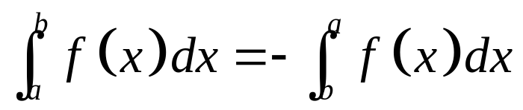
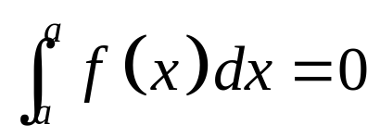
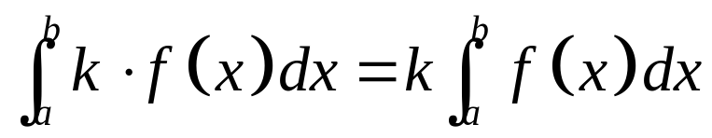

These are the rules for working with integrals, the most important of which are:
Reversing the limits changes the sign.
1.
If the upper and lower limits are equal, then the integral is zero.
2.
3.
Constant multiples can be moved outside.

Slide 3
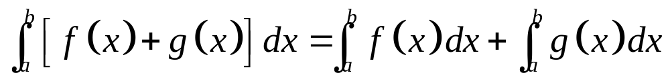
1.
Reversing the limits changes the sign.
2.
If the upper and lower limits are equal, then the integral is zero.
3.
Constant multiples can be moved outside.
4.
Integrals can be added and subtracted.

Slide 4
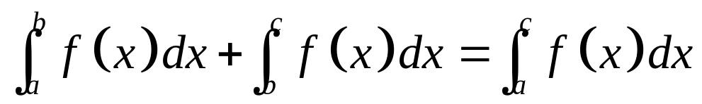
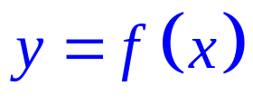



4.
Integrals can be added and subtracted.
5.
Intervals can be added
(or subtracted.)

Slide 5
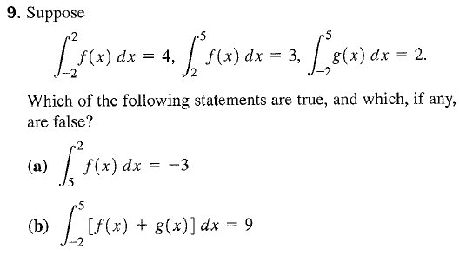
Now you try!

Slide 6
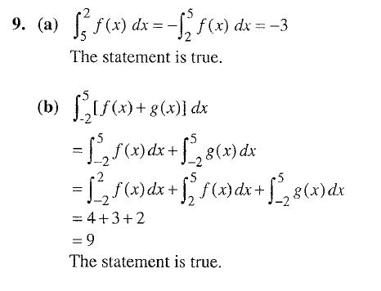

Slide 7
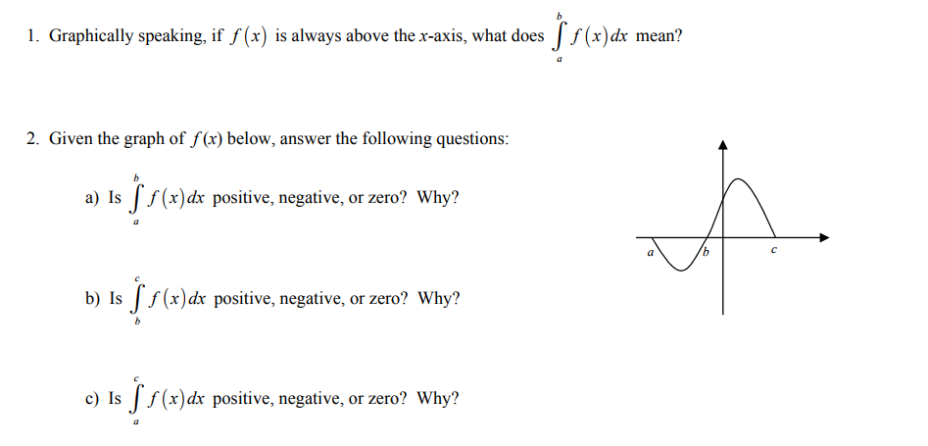
Integrals and Area
Notes:
Area under curve from a to b, negative since under the curve, positive since over the curve, positive since the bc area is bigger than the ab area

Slide 8
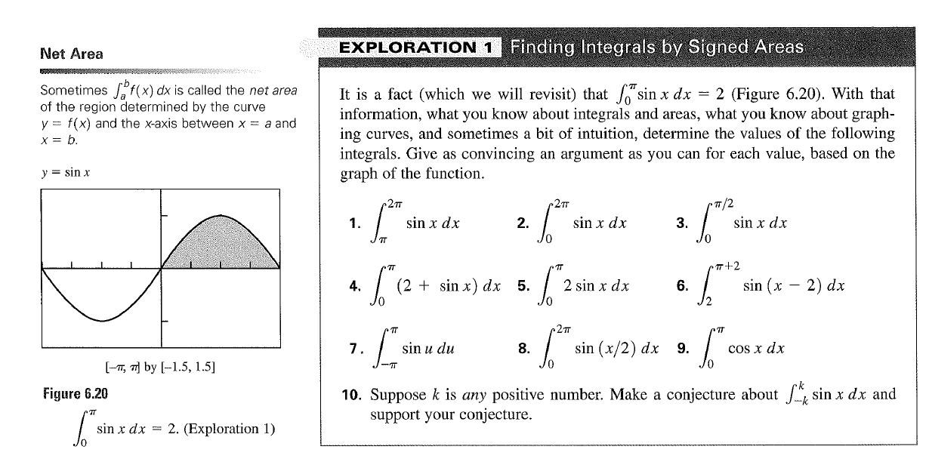
Integrals and Area Cont.
Notes:
#1-3, #4, #5, #8

Slide 9
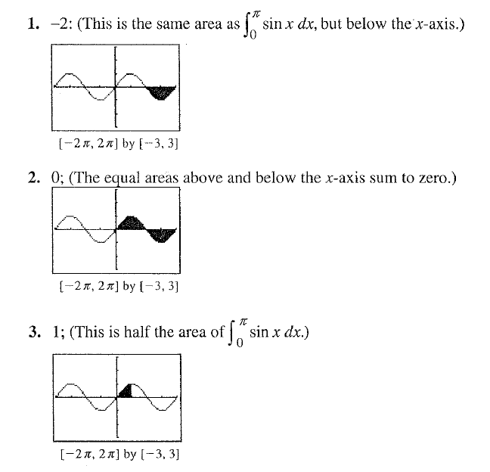

Slide 10
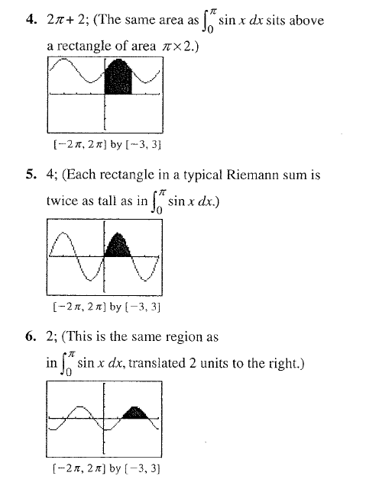

Slide 11
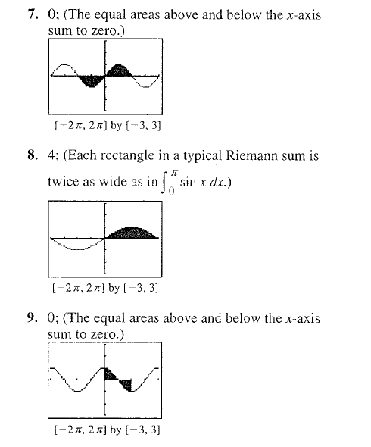

Slide 12
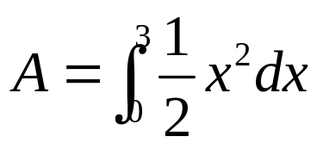

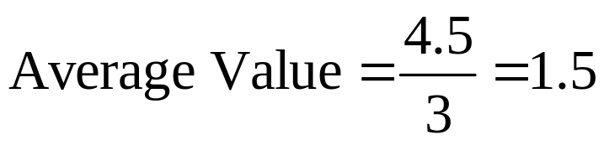

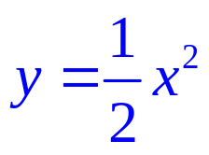
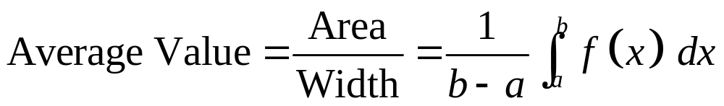
The average value of a function is the value that would give the same area if the function was a constant:

Slide 13
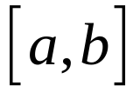
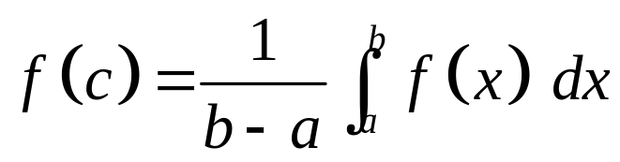
The mean value theorem for definite integrals says that for a continuous function, at some point on the interval the actual value will equal the average value.
Mean Value Theorem (for definite integrals)
If f is continuous on then at some point c in ,
π

Slide 14
5.2 int. prop./avg. val.
Pg. 307: #13, #14a (int area)
Pg. 308: #44, #45, #55, #56 (int prop.)
Pg. 375: #49 (Avg. val., must use calculator)

